Slide 1
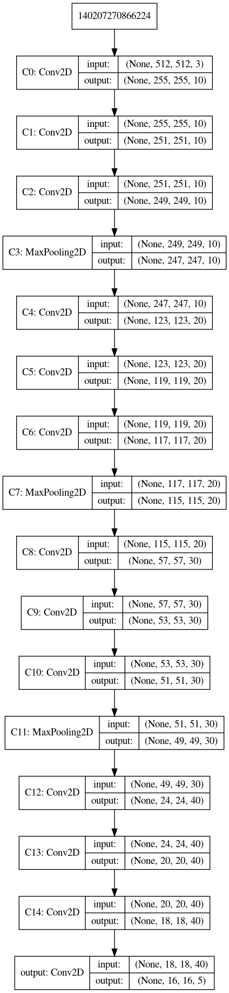
This Scientific Poster Template Is Provided By MakeSigns LESION DETECTION AND CLASSIFICATION
Bhairavsingh Ghorpade, Akhil Potdar, Uma Kaippa
Dept. of Data Science and Analytics, University of Oklahoma
Abstract
Problems
Results
Conclusion
Image Classification into body parts :
Inputs :
Outputs :
Data Description:
Data Source
Lesion Detection
Inputs :
Outputs
Data Description:
Data Source
Add your information, graphs and images to this section.
Add your information, graphs and images to this section.
Introduction
Approach
Convolution neural networks have proven to be highly significant in the field of biomedical image processing and have provided extremely insightful predictions object classification and detection models for various datasets.
Our dataset, named DeepLesion, is composed of 32,735 lesions in 32,120 bookmarked CT slices from 10,594 studies of 4427 unique patients. We have used a subset of 9816 images containing the CT scans of all the 8 body parts for both classification and lesion detection.
In our project, we have undertaken the challenge of classifying and detecting the lesion without the use of a pretrained network.
The use of CNNs to detect the lesion for different body parts is not just interesting but equally challenging since each of part has a different structure and the location of the lesions are random.
A validation of the presence of the lesion and their specific locations on the CT scanned images requires a very powerful model as lesion detection and classification is a very critical part of medical diagnosis so timely treatment can be provided to the patient.
Image Classification into body parts :
Modeling approach
Architectural decisions
Reasons
Lesion Detection
Modeling approach
Architectural decisions
Reasons
Acknowledgements
Dr.Dee H. Wu, Associate Professor, Department of Radiological Sciences. OUHSC.
Dr.Andrew Fagg, Department of Computer Science, University of Oklahoma.
11 intermediate Convolution layers along with 3 Max-Pooling Layers which are used after 3 consecutive conv layers

Slide 2
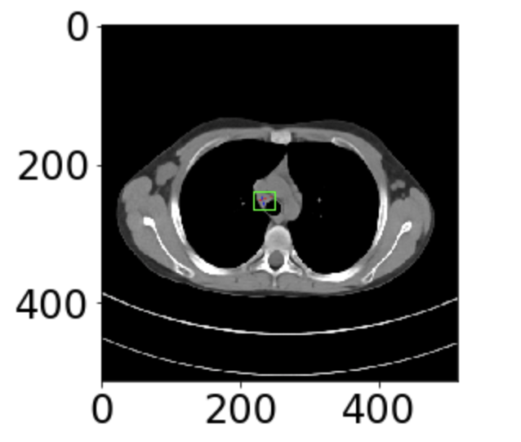
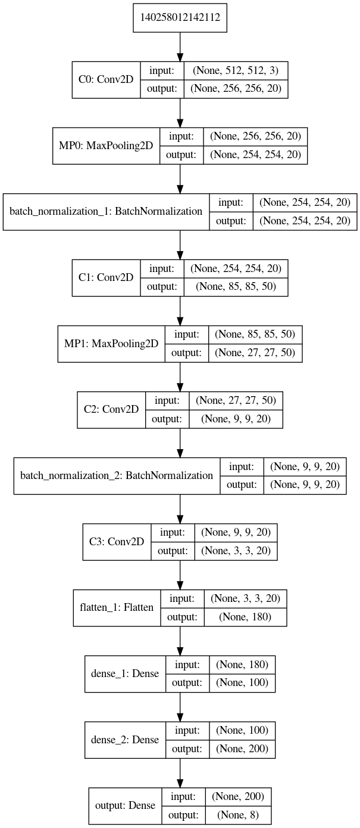
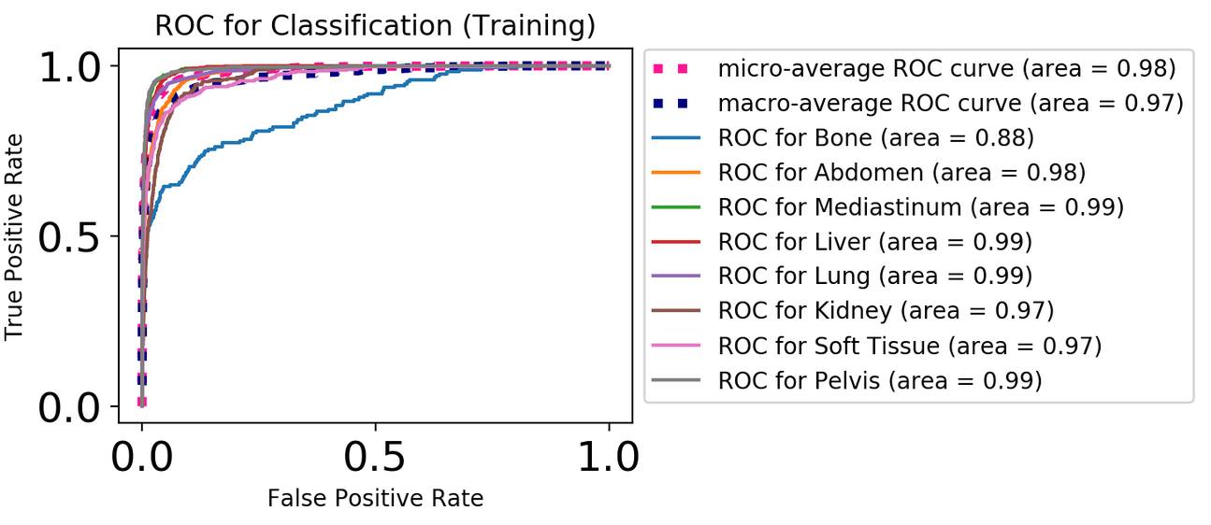

11 intermediate Convolution layers along with 3 Max-Pooling Layers which are used after 3 consecutive conv layers

